Slide 1
EQV Demo Vehicle Architecture
Heiko Wilken / Stefan Maier

Slide 2
Agenda
01 | Component Overview
02 | Communication Architecture
03
04
05
06
07
08
09
10
11
12

Slide 3
01
Component Overview

Slide 4



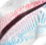
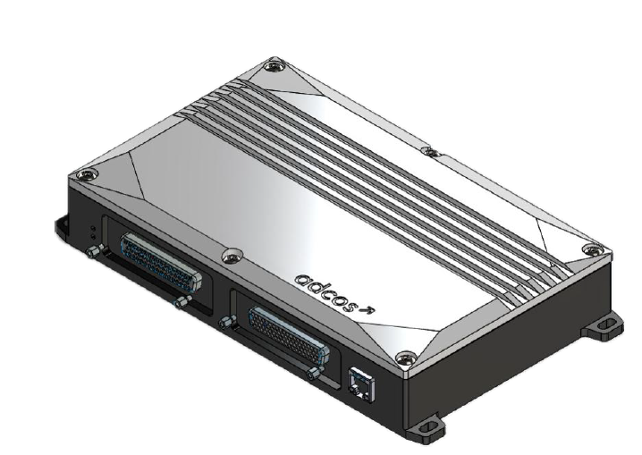
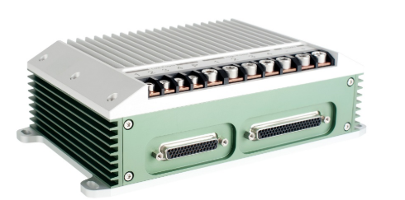
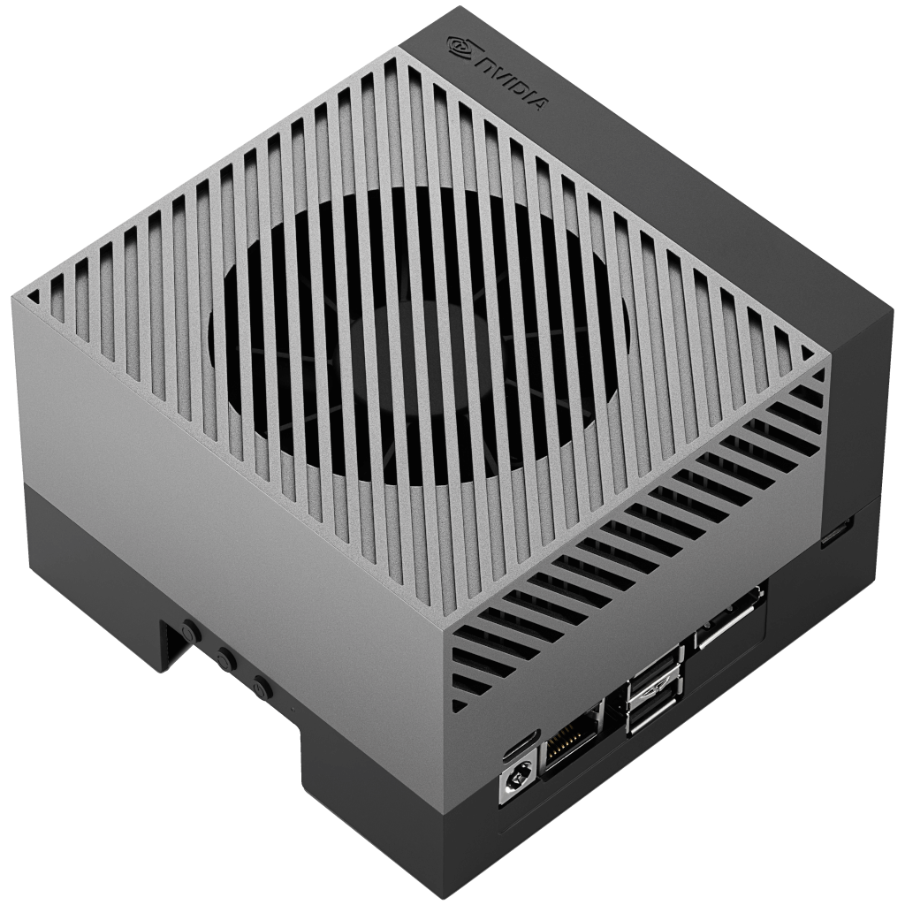
Demo CAR Components Architecture
The Demo Car is stacked with different system components from ZF-Liftec product portfolio (see examples at: https://zf-lifetec.com/products). Each seat contains at least:
ACR8/ACR8s (Active Controlled Reatractor)
ABL/ACB (Active Buckle Lifter/Active Controlled Buckle) with ISB (Illuminated Seat Buckle)
HB 2.0 (Heated Belt)
For more detailed information of the components see next slide
All this components are controlled via Rapid Prototyping Units
Adcos Panther
Adcos Puma PTM
Nvidia Jetson Orin
&

Slide 5
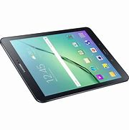
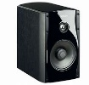
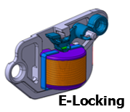
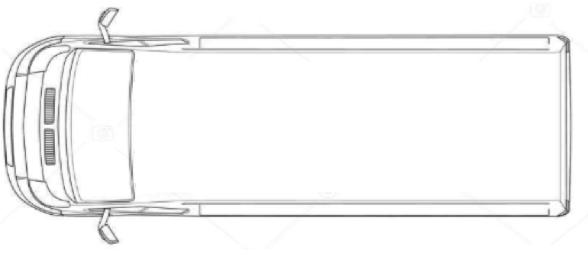


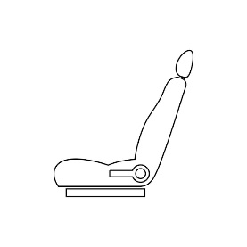



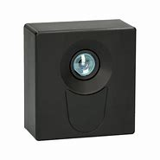
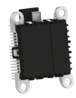








DEMo CAR Architecture
2. Row Reverse Seats with
ACR8.S with WMS
E-Locking
Heatbelt
ACB Buckle with ISB
Rotation Sensor
Seat Requirements
Full electrical adjustable
Seat heat sensor
Seat position sensor
Rotation and Uplift mechanism
Passenger Seat with
48V ACR with WMS
Heatbelt
ISB
Weight Sensors
Tablet for control and visualization
Advanced Occupant Safety Strategy for Adaptive Restraint with Loudspeaker
(IRS Firing)
Backbone
48V
TOF
Radar
Child Presence
(SIMI)
IR
Radar
Zero-G
TOF camera
Occupant Monitoring and Classification
(SIMI)
Seat Ramp
Driver Seat with
ACR8 & WMS
IR Belt
ISB
Weight Sensors
SWS with HOD and HMI
Zero G Seat with
ACR8.S with WMS
E-Locking
Heatbelt
ACB/ABL Buckle with ISB
Reversible Seat Ramp
Backbone with
Rapid Prototype Boxes
Data Loggers
Sound Generator with Loudspeaker
Airbag Deployment Simulator
Router and Power Supply
Steering Wheel with HOD and HMI - Demonstrator for Vitality and Vibration Motor and
new IRS deployment
2025-03-20 | Heiko Wilken | ZF LIFETEC

Slide 6
02
Communication Architecture

Slide 7
Communication Architecture
The main data exchange between the rapid prototyping units and the Car-PC should be CAN
ZF-Liftec will define a DBC-File for the CAN Bus definition and signal conversion rules.
First draft of the Panther to CAR-PC interface can be seen in the provided excel sheet (DRAFT).
In case of direct ECU/ rapid prototyping unit parameterization XCP Protocoll via Ethernet can be used.
ZF-Liftec will ship A2L Files where the IP-Adresses and Ports of each ECU are defined as well as parmeters and measurement variables.
For exchange of video streams the same Ethernet connection can also be used to transfer the video stream
SIMI (100% subsidiary company) will provide details for it when necessary.

Slide 8

DEMo CAR Bus Communication
Responsibility
LTS
SIMI
Visualization and Control Panel Server
CAR-PC
Simi
DMS and OMS
(ORIN/Jetson Nvidia)
RDU
CAN
Crash Sensor FL
Crash Sensor FR
CAN
Tablets
Data Logger
DBC
Vehicle CAN
THINK
Panther
Adaptive
Restraint
Digital or Analog Wired
Body CAN
eLocking ECU
DBC
DBC
CAN
CAN
DBC
CAN
ACT
PUMA PTM
Driver
ACT
PUMA PTM
Passenger
ACT
PUMA PTM
Seat RL2
Rear normal
ACT
PUMA PTM
Seat RL1 Rear reverse
Zero G Seat
Crash Visualization and Acustic
ACT
PUMA PTM
Seat RR1
Reversible
Seat Ramp
CAN / LIN from single IEE-ECUs (installed under the Seats)
2026-02-16 | RDUE2-Algo Team | ZF LIFETEC

Slide 9

Ethernet Communication Setup (draft)
Responsibility
LTS
SIMI
RDU
CAR-PC (Visualization)
ETH Cat XX
Router
Switch
ETH Cat XX
ETH Cat XX
ETH Cat XX
ETH Cat XX
ETH Cat XX
ETH Cat XX
ETH Cat XX
Nvidia Jetson (SIMI)
THINK
Panther
ACT
PUMA PTM
Driver
ACT
PUMA PTM
Passenger
ACT
PUMA PTM
Seat RL2
ACT
PUMA PTM
Seat RR1
ACT
PUMA PTM
Seat RR1

Slide 10
DEMo CAR system Architecture – IEE Components
Responsibility
Responsibility by IEE
CAR-PC
JETSON
SIMI Algorithm
Responsibility by SIMI
Ethernet
Responsibility by RDU
DBC
Responsibility by LTS
LDF
Ethernet
IEE Radar
THINK
Panther
LIN
DBC
CAN
ACT
PUMA PTM
Driver
ACT
PUMA PTM
Passenger
ACT
PUMA PTM
Seat RL2
ACT
PUMA PTM
Seat RR1
ACT
PUMA PTM
Seat RR1
LIN
LDF
IEE ECU
IEE ECU
IEE ECU
IEE ECU
IEE ECU
IEE Seatmat
Driver
IEE Seatmat
Passenger
IEE Seatmat
Seat RL2
IEE Seatmat
Seat RR1
IEE Seatmat
Seat RR1
2026-03-13 | RDUE2-Algo Team | ZF LIFETEC

Slide 11
CONTACT
Name Surname Job title 0123 - 456 789 0 n.surname@zf.com

